Slide 1
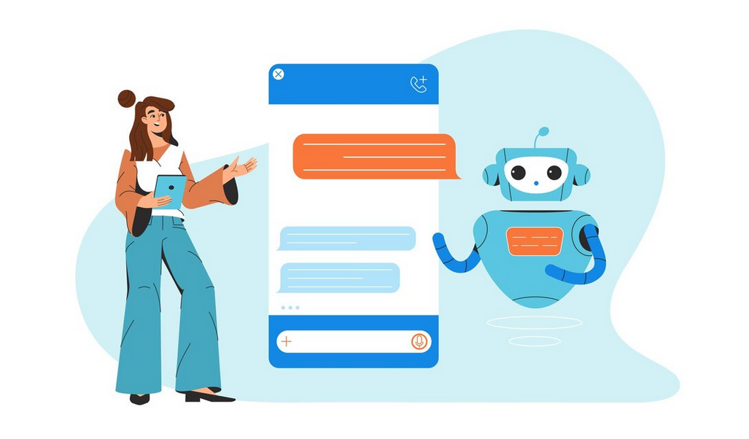
Streamlit-powered Chatbot with GPT-4 Integration
Project by:
Vaishnavi Patil
ID: 20133
Course: Generative AI-Driven Intelligent Apps Development
Date: October 2024
Prof: Dr. Chang, Henry

Slide 2
Table of Contents
Introduction
Design
Implementation
Testing
Enhancement Ideas
Conclusion
References
Appendix

Slide 3
Introduction
Project Overview:
Develop a web-based chatbot using Streamlit and GPT-4 API.
Implement a visually appealing UI with a shaded blue gradient.
Purpose:
Create an interactive chatbot to answer user queries.
Technologies Used:
Streamlit, Python, OpenAI GPT-4 API, CSS for styling.

Slide 4
Design - Problem Identification
Why This Approach?
Problem Identified:
Need for Efficient Human-Computer Interaction
Demand for Scalable and User-Friendly Interfaces
Maintaining Conversational Context
Integrating Real-Time Response Generation
Customizing User Experience with Visual Appeal
Accessibility and Deployment Challenges
Future Proofing and Scalability
Solution Requirements:
A simple, scalable, web-based chatbot.
Integration with GPT-4 for dynamic responses.
Custom background for enhanced UX.

Slide 5
Design - Investigating Solutions
Possible Solutions:
Option 1: Building a custom backend API and web interface from scratch.
Option 2: Using pre-built web frameworks like Streamlit or Flask.
Chosen Approach:
Streamlit for faster prototyping and simplicity.
OpenAI GPT-4 API for powerful, real-time response generation.
CSS Styling for enhancing user experience.

Slide 6
Implementation - How It Was Built
Code Setup:
Using Python to manage OpenAI API integration.
CSS: Applied for custom gradient background and "Powered by Streamlit" footer.
Session Management: Streamlit’s session state to manage chat history.
API Streaming: Real-time response streaming with OpenAI's GPT-4.

Slide 7
Testing - Chatbot Functionality
Testing Steps:
Tested for different user inputs to ensure meaningful responses.
Verified session persistence (conversation history stored).
Ensured background and footer styling is consistent across all devices.
Test Cases:
Short queries vs. complex queries.
Checking response generation speed (around 2-3 seconds for complete response)
Verifying correct CSS rendering.

Slide 8
Enhancement Ideas
Improvements to Consider:
Voice Input: Integrating speech-to-text for voice queries.
Multiple Models: Allow users to choose between different OpenAI models.
Analytics Dashboard: Add metrics to track user interaction with the chatbot.
Dark Mode: Implement a toggle between light and dark themes.

Slide 9
Conclusion
Successfully developed a chatbot using Streamlit and OpenAI’s GPT-4 API.
Implemented session handling and styled the UI with a gradient background.
Streamlit's ease of use facilitated rapid development.
GPT-4 API provided strong, real-time conversational capabilities.

Slide 10
references
Technologies Researched:
Streamlit Documentation: Used for web app framework setup.
OpenAI API Documentation: For integration of GPT-4 model.
CSS Gradients: Researched gradient styling techniques.
Information Literacy Search Technique:
Searched for chatbot technologies, real-time streaming, and web development frameworks.
OpenAI_API_ChatBot_Streamlit

Slide 11
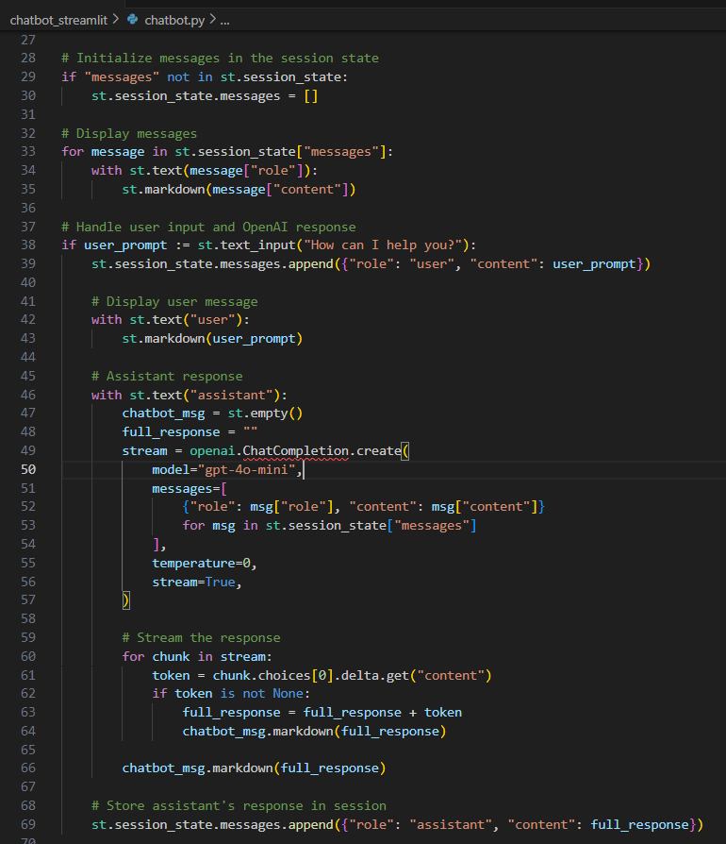
APPENDIX

Slide 12
